Slide 1
04.01 Meeting - 25
吳定洋
1

Slide 2
Table of contents
01
Proposed model – Regressor_DNN (Temp.)
Methodology
Experiment
Conclusion
2

Slide 3
Methodology
3

Slide 4
Regressor_DNN model architecture, using 2mcAP(Best) as example
Original 2 mcAP
raw data
SGDRegressor
Data Combination
Input data
Input: AP1/AP4 RSSI & Distance
Output: Distance Predictor
3 Layer DNN model
Distance Predictor
Regressor_DNN
2 mcAP
data
Input: AP2/AP3 RSSI
Output:
AP2_Distance_predicted AP3_Distance_predicted
IPS
Data preprocessing for DNN model
Regressor
DNN model
4

Slide 5
Training data for DNN model, using 2mcAP(Best) as example
Original 2 mcAP(Best) Model:
Features：
Regressor_DNN 2 mcAP(Best) Model :
Features：
AP1_Rssi | AP2_Rssi | AP3_Rssi | AP4_Rssi | AP1_distance | AP4_distance | AP1_StdDev | AP4_StdDev
AP1_Rssi | AP2_Rssi | AP3_Rssi | AP4_Rssi | AP1_distance | AP4_distance | AP1_StdDev | AP4_StdDev
AP2_Distance_predicted | AP3_Distance_predicted
Original 2 mcAP(Worst) Model: mcAP are AP2 and AP3 so the Distance_predicted are AP1 and AP4
5

Slide 6
Experiment (1)
6

Slide 7
Comparison for 2mcAP(Best)
Train original model and Regressor_DNN model for 5 times to reduce random
5 times training result for Original
 | 1 | 2 | 3 | 4 | 5 | AVG
Accuracy | 98.46% | 98.97% | 99.07% | 98.31% | 98.79% | 98.72%
MDE | 0.0214 m | 0.0147 m | 0.0119 m | 0.0226 m | 0.0157 m | 0.0173 m
5 times training result for Regressor_DNN
 | 1 | 2 | 3 | 4 | 5 | AVG
Accuracy | 99.12% | 99.14% | 99.02% | 99.02% | 99.12% | 99.08%
MDE | 0.0135 m | 0.0103 m | 0.0141m | 0.0158 m | 0.0111 m | 0.0130 m
Regressor_DNN improves accuracy by approximately 0.36%
Regressor_DNN reduces MDE by approximately 24.7%.
7

Slide 8
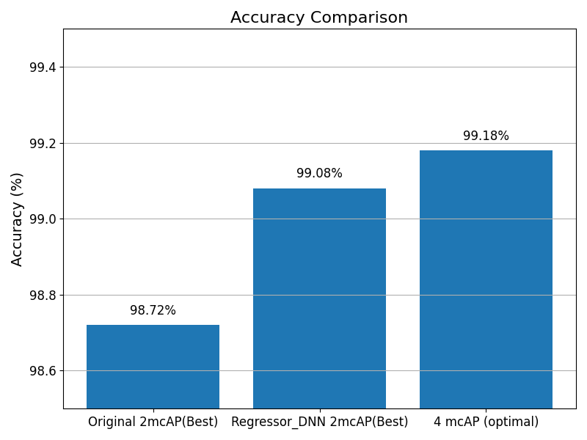
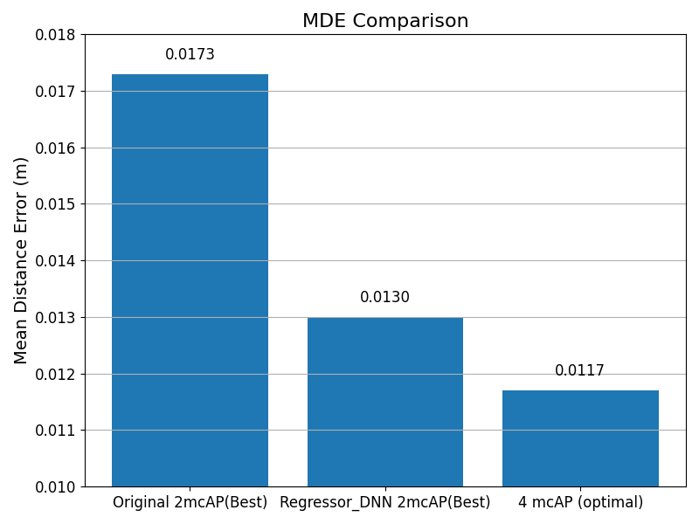
Comparison for 2mcAP(Best)
8

Slide 9
Comparison for 2mcAP(Worst)
Train original model and Regressor_DNN model for 5 times to reduce random
5 times training result for Original
 | 1 | 2 | 3 | 4 | 5 | AVG
Accuracy | 98.59% | 98.41% | 98.44% | 97.88% | 98.41% | 98.35%
MDE | 0.0276 m | 0.0307 m | 0.0302 m | 0.0470 m | 0.0293 m | 0.0330 m
5 times training result for Regressor_DNN
 | 1 | 2 | 3 | 4 | 5 | AVG
Accuracy | 98.49% | 98.84% | 98.66% | 98.82% | 98.72% | 98.71%
MDE | 0.0241 m | 0.0191 m | 0.0211 m | 0.0199 m | 0.0248 m | 0.0218 m
Regressor_DNN improves accuracy by approximately 0.36%
Regressor_DNN reduces MDE by approximately 33.9%
9

Slide 10
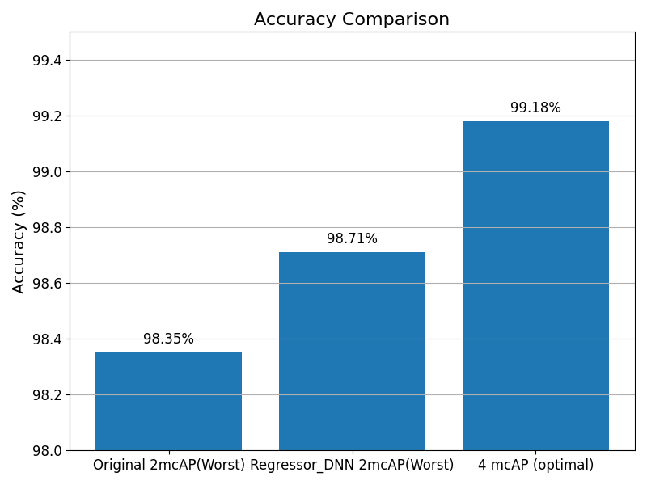
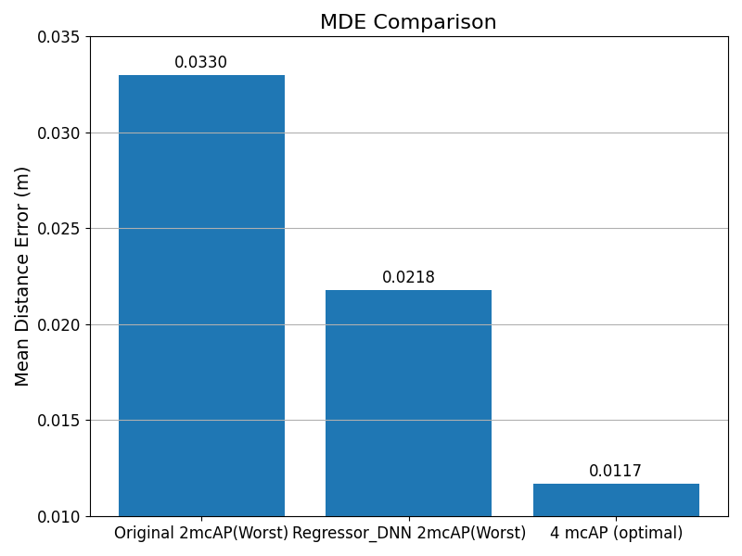
Comparison for 2mcAP(Worst)
10

Slide 11
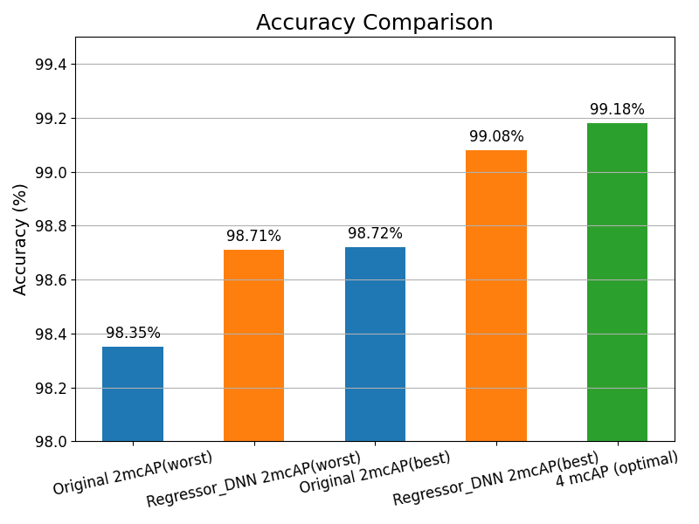
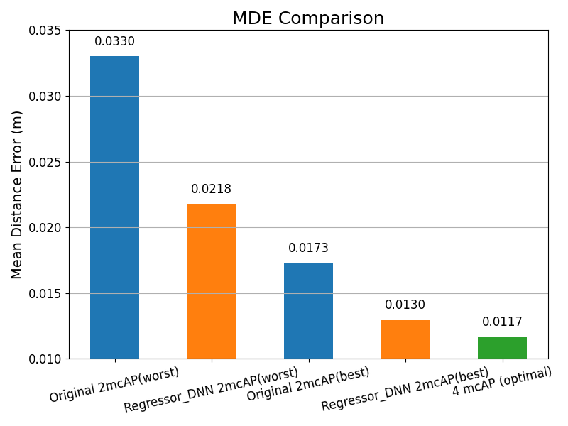
Comparison for 2mcAP(Best), 2mcAP(Worst)
11

Slide 12
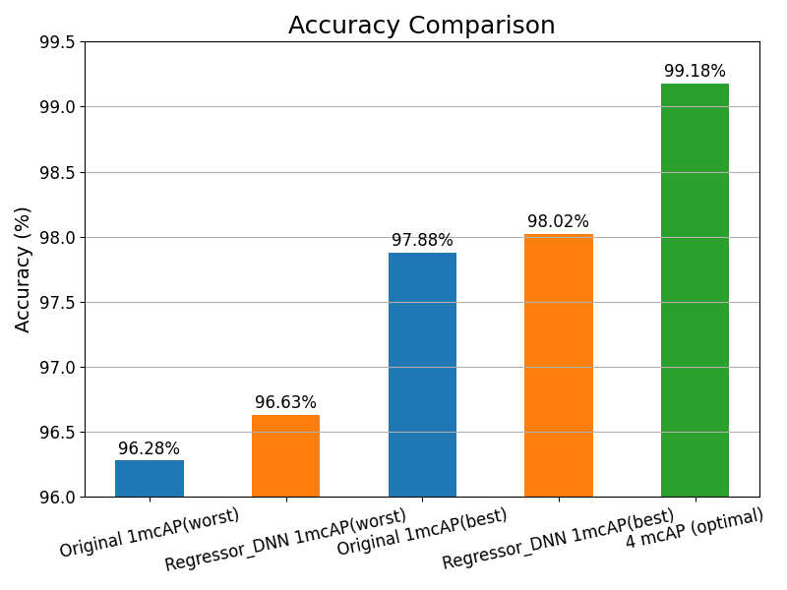
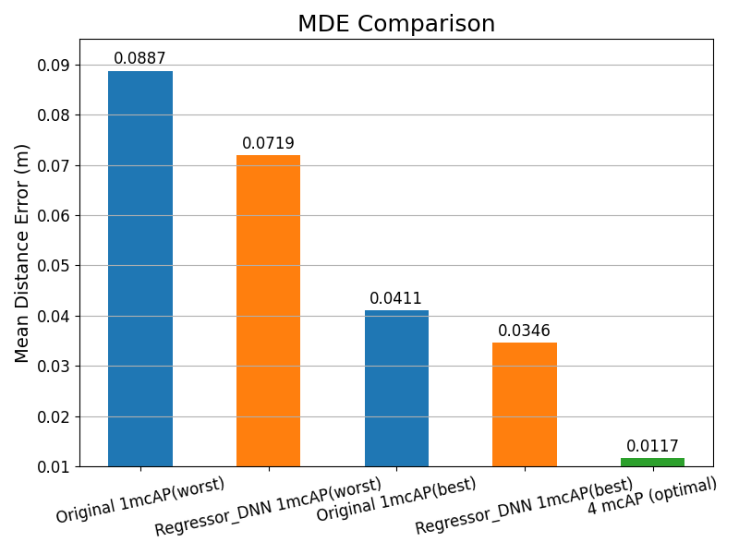
Comparison for 1mcAP(Best), 1mcAP(Worst)
The difference between 1 mcAP using Regressor_DNN and 2 mcAP using Regressor_DNN lies in the amount and diversity of training data available. 2 mcAP has access to a larger dataset for training the regressor and includes AP data from different locations, allowing it to capture more spatial information.
12

Slide 13
Experiment (2) Fine-tuing for Regressor_DNN
13

Slide 14
Comparison for 2mcAP(Best)
Base Model
Using 2024/12/14 400 training data per RP
Original 2 mcAP(Best) Model
Regressor_DNN 2 mcAP(Best) Model
Fine-tuning design for Regressor_DNN
Partial fit SGDRegressor
Freeze Hidden Layers，only re-train Output Layer
fine-tuning data per RP：20 new data (5%)
Observe 1~4, 8 week fine-tuning result
14

Slide 15
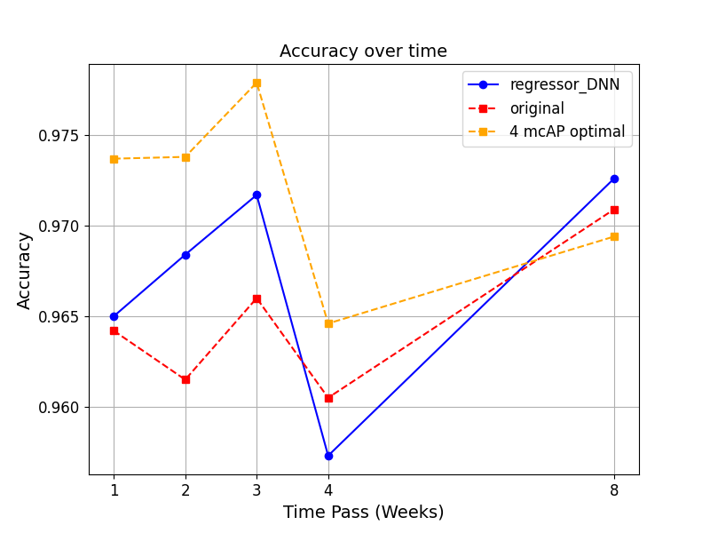
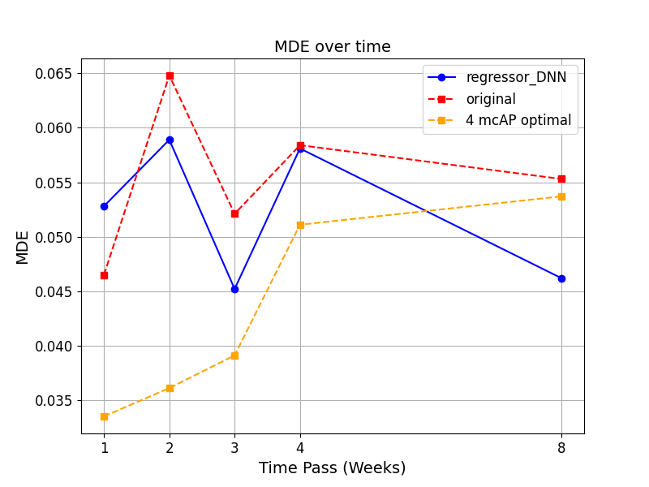
Comparison for 2mcAP(Best)
15

Slide 16
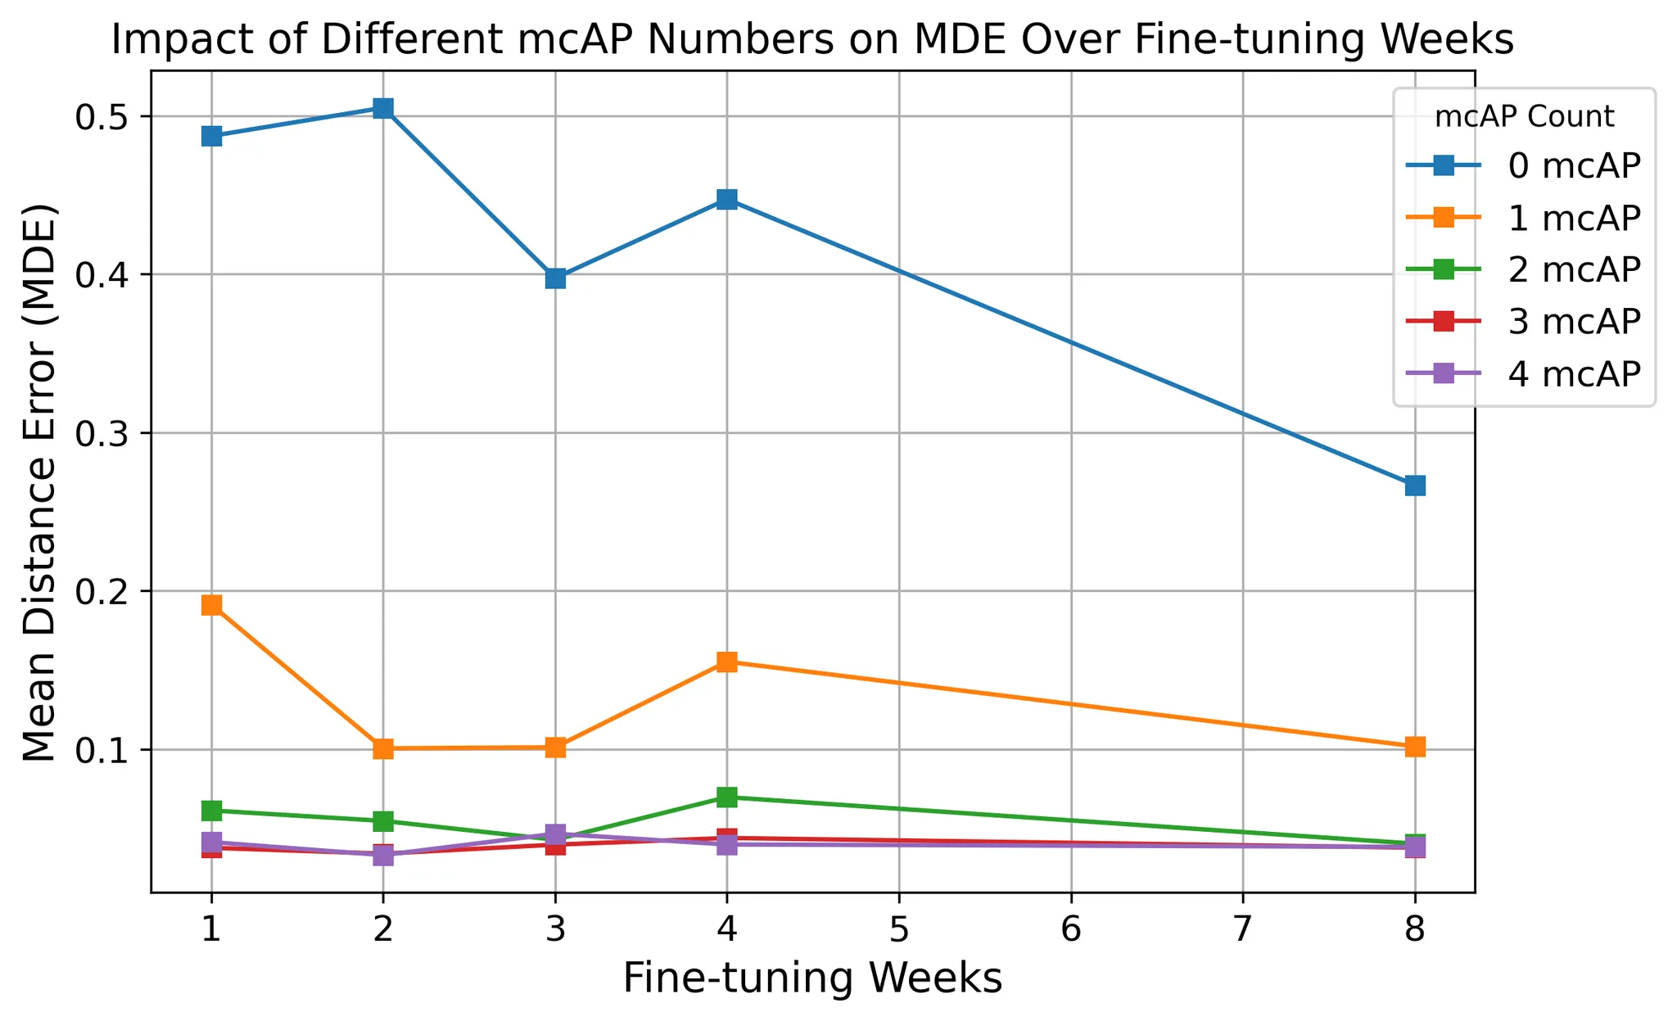
Comparison for 2mcAP(Best)
Based on previous experiments, baseline model—which relies solely on 4 RSSI values—suffers more from performance degradation over time. As time passes, the effect of RSSI drift becomes more pronounced, leading to weaker performance even after fine-tuning.
the model does not show significant improvements in the early weeks when the training data is limited and RSSI drift is still strong.
16

Slide 17
Conclusion
17

Slide 18
The proposed Regressor_DNN model, when trained with sufficient data from the same week, is able to effectively improve accuracy and reduce MDE
The proposed Regressor_DNN model performs well when data is sufficient, such as using training data from the same week. However, in cross-week scenarios, where the input RSSI distribution may drift over time, performance gains are less stable. In such cases, the model either requires more fine-tuning data or more stable RSSI input to achieve significant improvements.
18

Slide 19

Thanks for Listening!
19

